Slide 1

OVERVIEW OF DEVELOPMENT TOOLS
Full Stack Development Tools
Presented by Ramineni Usha
CITY ENGINEERING COLLEGE

Slide 2

Agenda
Introduction
Overview of full stack development
Postman
API testing tool insights
Eclipse
Java IDE features
Java
Core backend programming language
HTML
Structure of web pages
CSS
Visual design for web content
GitHub
Version control platform
MySQL
Relational database management
Project Explanation
Overview of Gaming Club Admin project
Summary
Recap of tools and integration
Q&A
Invite audience questions and feedback
Agenda

Slide 3

Understanding Full Stack Development: Concepts and Essential Tools
Full stack development encompasses the frontend, backend, and database layers, creating a seamless web experience. Each tool, including Postman, Eclipse, Java, and others, plays a crucial role in ensuring efficient and effective end-to-end development, facilitating collaboration between various components of the application architecture.

Slide 4
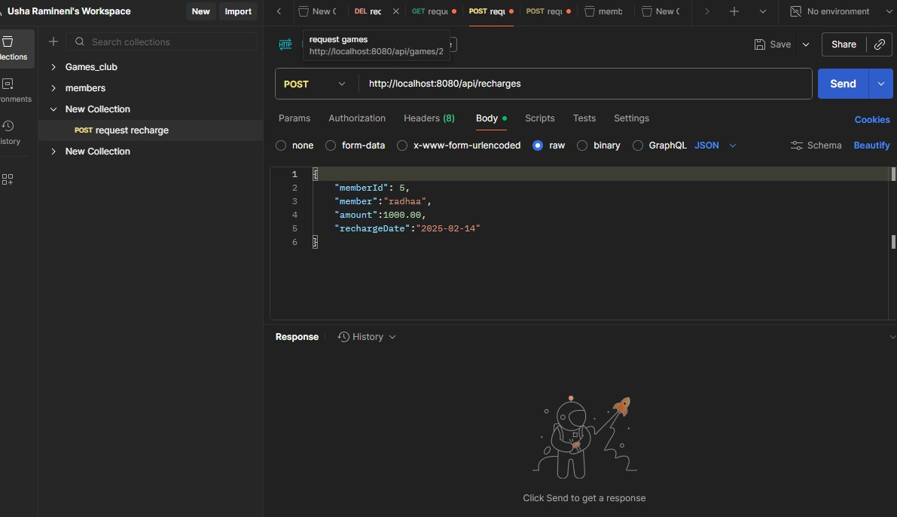
Postman: Powerful API Testing Tool
API Testing and Debugging
Postman simplifies API development with features for testing and automation.

Slide 5
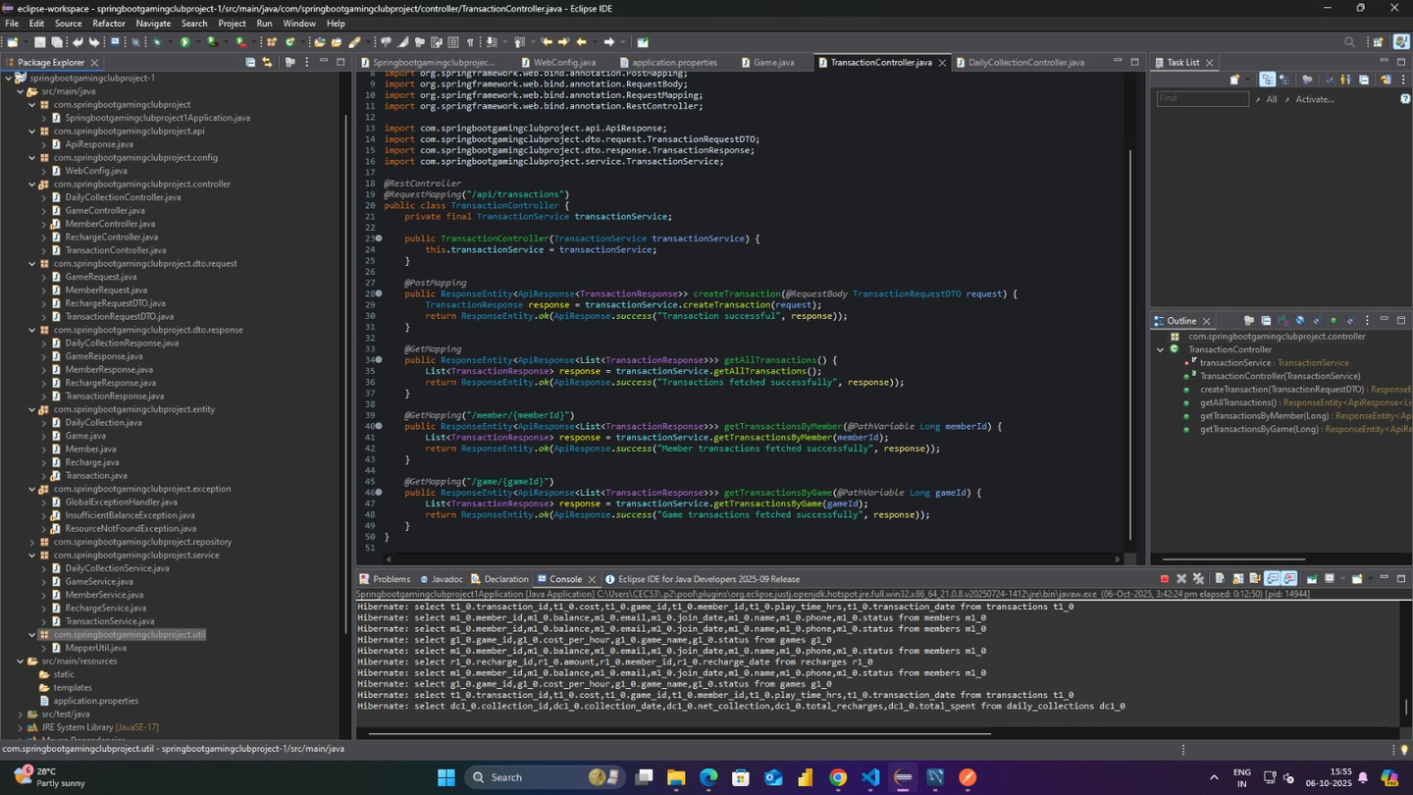
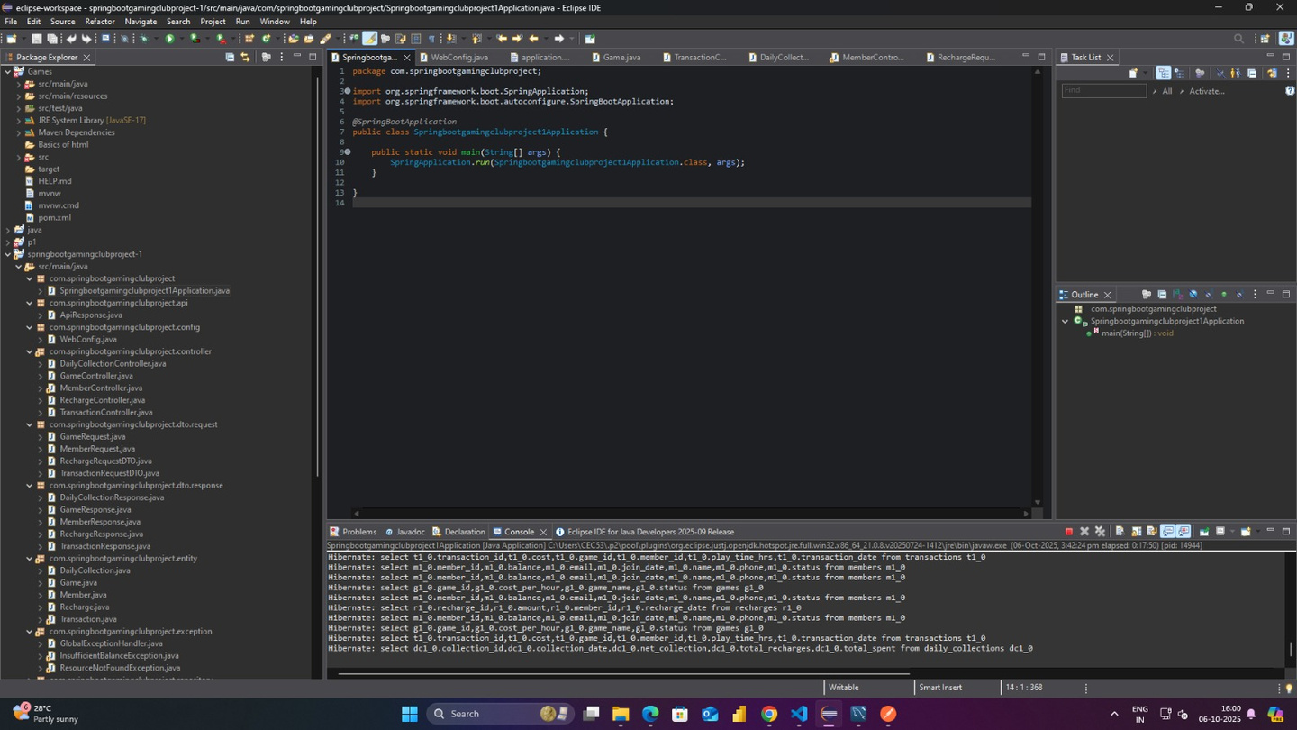
Eclipse IDE: Java Development Environment Insights
Integrated Development Environment
Eclipse simplifies Java coding and debugging with powerful features.

Slide 6
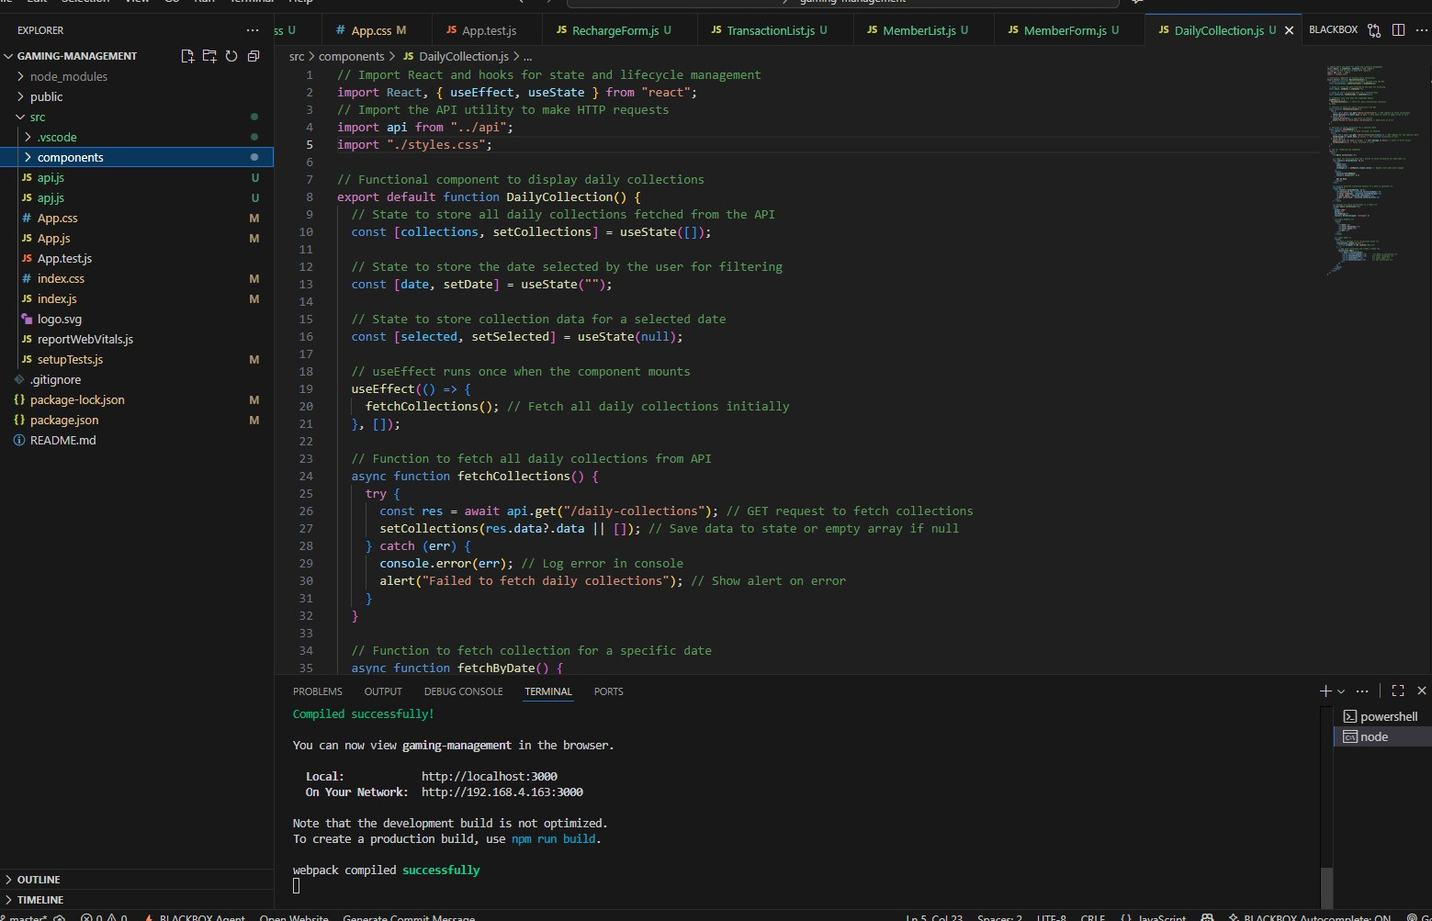
Java: Core Backend Programming Language
Backend Development Essentials
Java powers critical business logic for seamless application functionality.

Slide 7
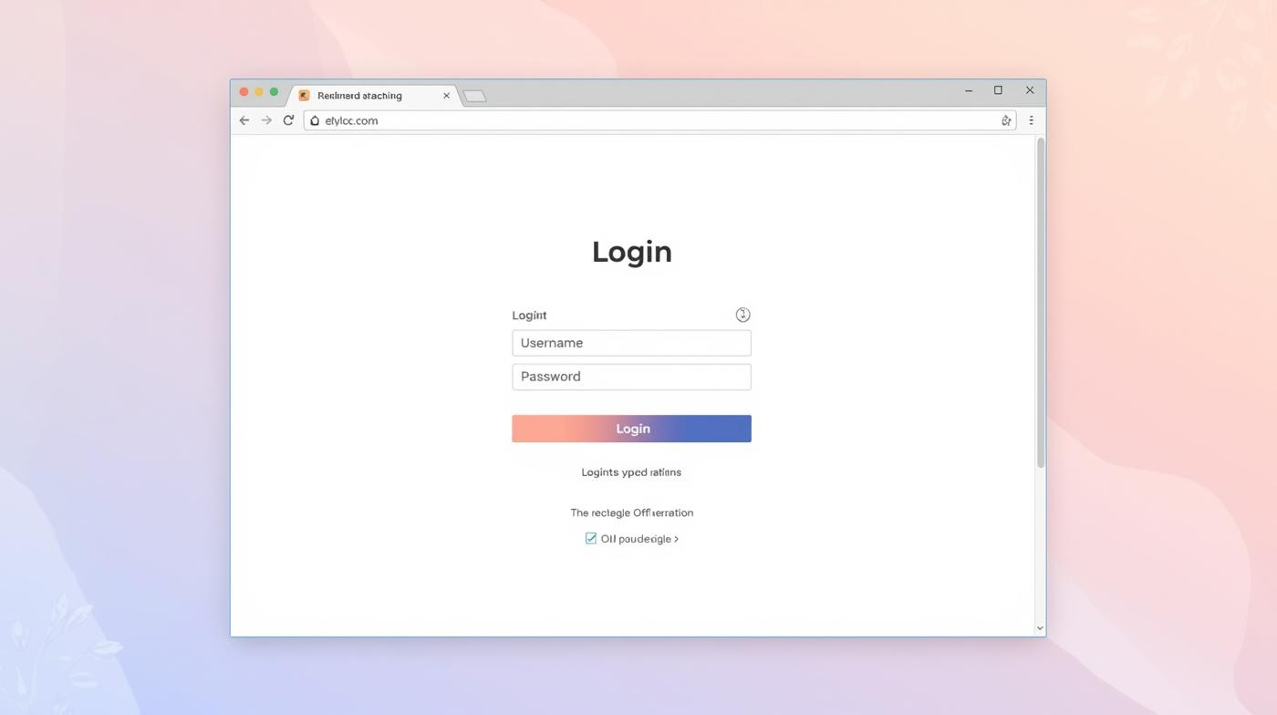
Understanding HTML for Web Development
Introduction to HTML
HTML is essential for creating and structuring web page content.

Slide 8
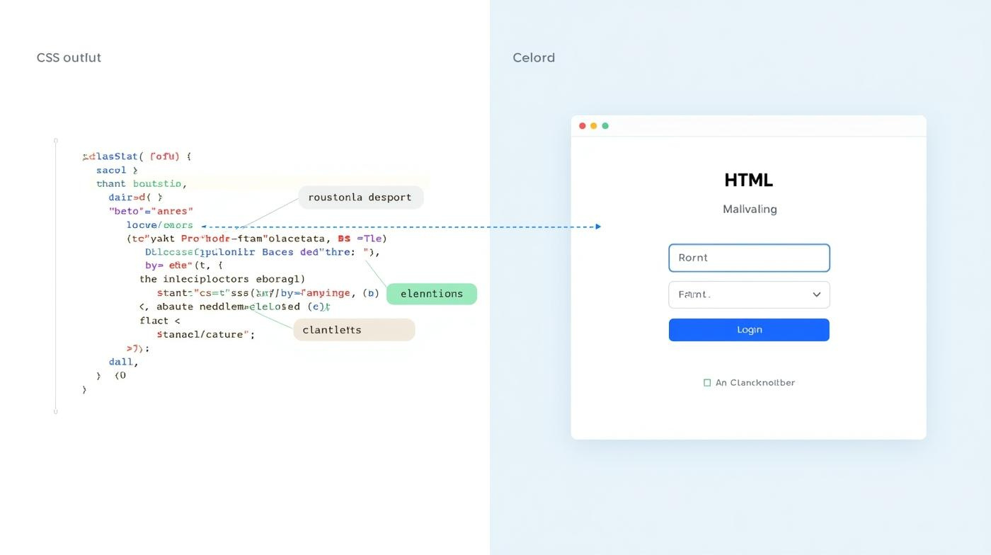
CSS: Styling and Design Fundamentals
Visual Design Elements
CSS enhances the appearance of HTML content, creating visually appealing web pages.

Slide 9
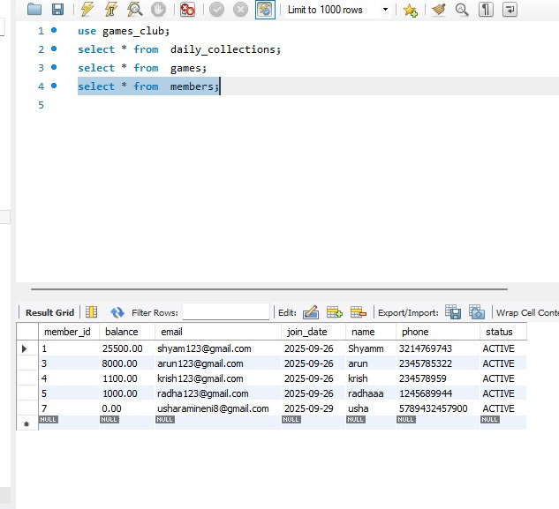
MySQL: Relational Database Management System Overview
Database Management Essentials
MySQL enables efficient data storage and management for robust applications.

Slide 10
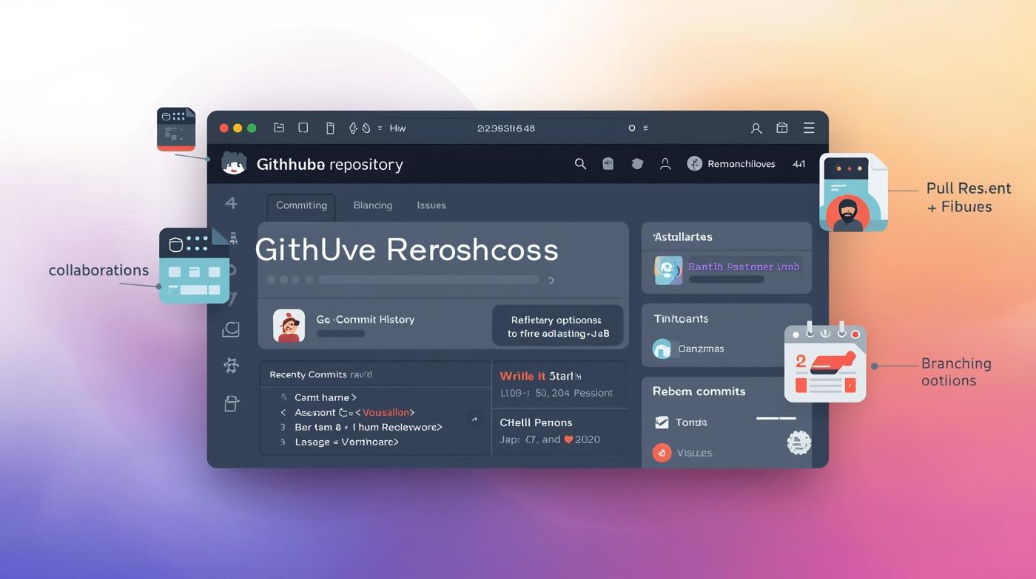
GitHub: Essential Tool for Collaboration
Version Control Overview
GitHub enables efficient collaboration and version control for software development teams.

Slide 11
The Employee Management System for the Gaming Club Admin is designed to facilitate smooth operations in managing club members, games, transactions, and daily collections. This project integrates various technologies: the frontend utilizes HTML and CSS for a user-friendly interface, while the backend is powered by Java, interacting with MySQL for data storage. Postman is employed for API testing to ensure seamless communication between the frontend and backend. GitHub plays a crucial role in managing version control and collaborative efforts among developers, ensuring a cohesive workflow across the project.
Gaming Club Admin Workflow

Slide 12
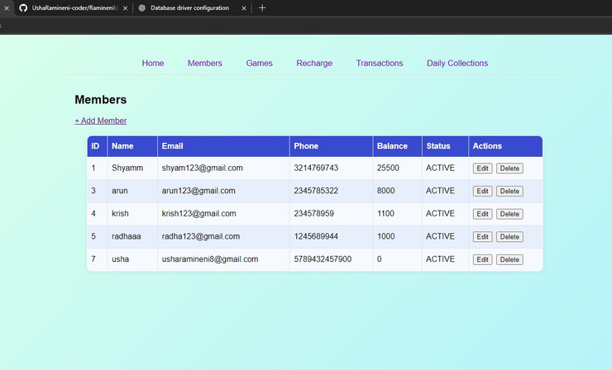
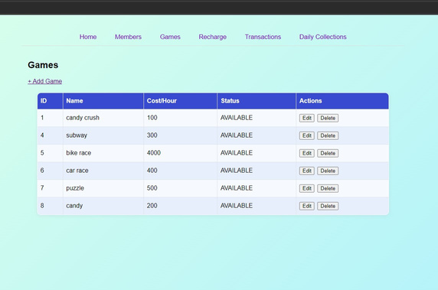
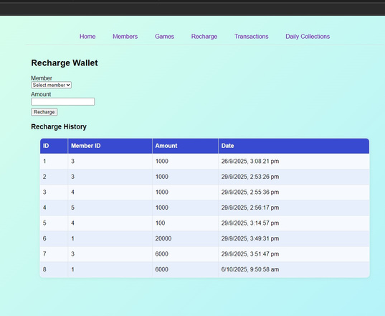
Overview of Gaming Club Admin Project
Members Page
Games Page
Recharge Page
Manage and view all club member details.
Add, edit, or remove games effectively.
Facilitate wallet recharges and track history.

Slide 13
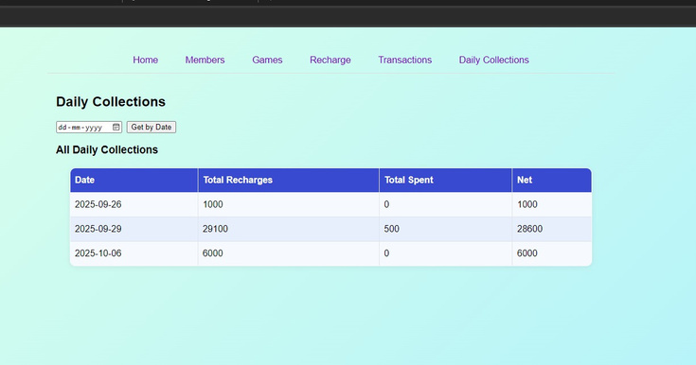
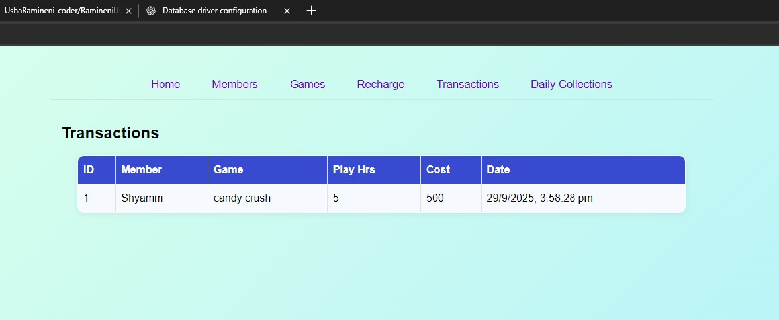
Overview of Gaming Club Admin Project
Daily Collections Page
Transactions Page
Explore and access comprehensive information about each club member.
Facilitate wallet recharges, track history effortlessly.

Slide 14
In summary, the journey through full stack development has illuminated the essential tools that create a cohesive workflow. Each tool, from Postman for API testing to MySQL for data management, plays a critical role in bridging the frontend and backend. Understanding these tools is vital for successful development, as they enable developers to create, test, and deploy applications efficiently. As we integrate these technologies, we enhance our capability to build robust applications that meet user needs and industry standards.
Key Takeaways of Full Stack Tools

Slide 15

Questions and Discussion
We appreciate your engagement and inquiries
EMAIL ADDRESS
usharamineni8@gmail.com

